Slide 1
GUI-based Digital Clock using Python Tkinter Library
Azhar Ahmed (AI-405039) – AI and Data Science

Slide 2
Introduction
A digital clock is a clock that displays time digitally in hours, minutes, and seconds.
This project is built using Python Tkinter GUI.
Features:
- Real-time update
- 12-hour/24-hour toggle option

Slide 3
Abstract
The project demonstrates the use of Python’s Tkinter library to design a GUI-based digital clock.
It highlights the concept of real-time applications, event handling, and user interactivity.
Provides a simple yet practical application of programming concepts.

Slide 4
Problem Statement
Traditional clocks require manual design or hardware.
Many basic digital clock applications lack interactivity (e.g., switching between 12-hour and 24-hour formats).
Need for a lightweight, customizable digital clock built in Python.

Slide 5
Proposed Solution
Develop a Python-based digital clock with Tkinter.
Implement strftime() for real-time updates.
Provide a toggle button for switching between 12-hour and 24-hour formats.
Simple, portable, and customizable GUI design.

Slide 6
Conclusion
The project successfully demonstrates a real-time digital clock using Python Tkinter.
Offers user interactivity with 12hr/24hr switching.
Can be enhanced further with features like date display, alarms, or themes.

Slide 7
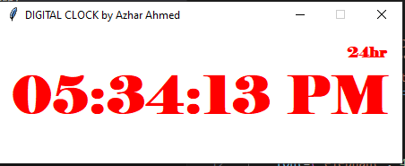
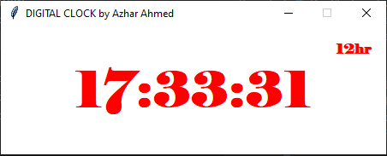
Output
12 hour format
24 hour format

Slide 8
Thank You

